Slide 1
ICT292 IS Management
Topic 02: The Role of Information Systems in Organisations

Slide 2
Topic Learning Outcomes
At the completion of this topic, you will be able to:
Explain how the value of information in an organisation can be measured
Describe the role of information architectures and information systems architectures in organisations
Explain a generic information lifecycle in terms of a particular set of information
Analyse, and be able to explain, the flows of information into, out of, within and between organisations

Slide 3
Unit Learning Outcomes
This topic contributes to the following Unit Learning Outcomes:
LO1: Demonstrate an understanding of the role of information in organisations, and how it is managed.

Slide 4
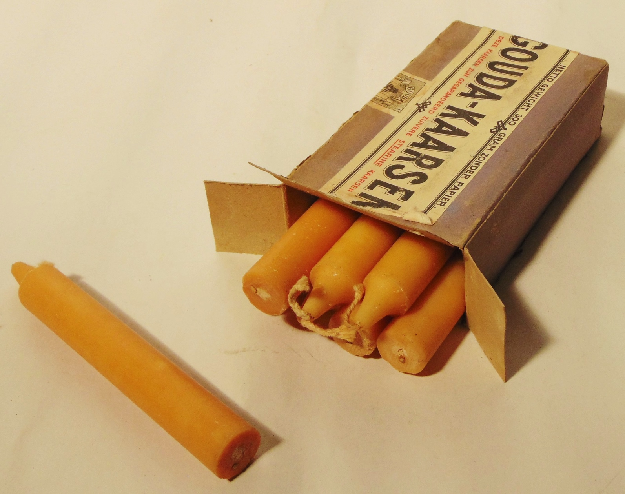
Resources for the Topic
Text Chapter 2
In particular, you should make sure that you have read the sections relevant to the Amy’s Candles case study
By KingaNBM - Own work, CC BY-SA 4.0, https://commons.wikimedia.org/w/index.php?curid=45689102

Slide 5
Topic Outline
Information in Organisations
Information Systems
Information Lifecycle
Summary

Slide 6
Information in Organisations

Slide 7
Measuring the Value of Information
The value of information is subjective depending on:
Who uses the information
When the information is needed
When the information is available
What purpose the information is needed for.
Information is aligned with the strategy and objectives of the organization

Slide 8
Characteristics of Information
Timeliness, when the information is available
Frequency, when the information is updated
Appropriateness to the task and the person performing the task.
Accuracy of the information.
Brevity, level of detail appropriate for the task.
Rarity, unusual information, anomalies.
Understandability of information to person receiving it.
Action, sufficient detail to initiate action by appropriate person.
Presentation, format of the information and degree of ambiguity.

Slide 9
Information Systems

Slide 10
Systems
A collection of interrelated elements that work together to achieve a defined aim.
boundary
subsystems
input
output
environment

Slide 11
Organisation as a System
Market
Products
Customers
Consumers
Organization
Resources
Competitors
Suppliers
Partners
Associations
Governments
Media
Business Environment
Business Climate
Figure 2.1

Slide 12
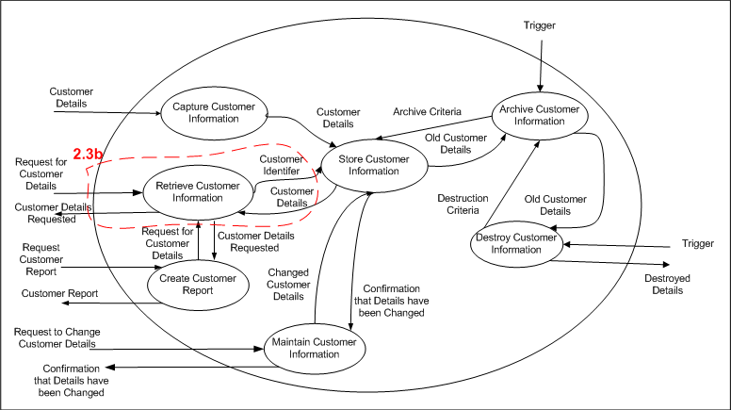
Information System
Structured collection of business processes to support each stage of the information lifecycle.
Figure 2.2

Slide 13
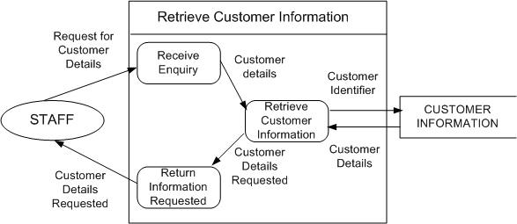
Data Flow Diagrams
Models the flow of data into, out of and between processes in an information system.
Figure 2.3b

Slide 14
Information Lifecycle

Slide 15
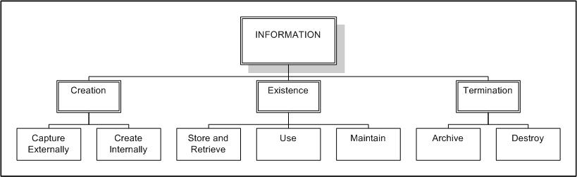
Information Life Cycle
Processes are needed to support each stage, and respond to each event triggered in the life cycle.
Information life cycle management suggests that the value of information may increase at the end of the life cycle.
Figure 2.5

Slide 16
Collecting and Organizing Information
Forms are used to structure data collection.
Organization of information depends on:
Who will need the information?
How will someone search for the information?
How much information is there to search through?
Figure 2.11

Slide 17
Entities and Attributes
An entity is something about which information is needed such as customers, products and orders.
An attribute is a characteristic of an entity.
If a value can be assigned to it, it is an attribute.
For example, an entity is supplier, attributes of a supplier are supplier name, supplier address and supplier email address.

Slide 18
Retrieving and Using Information
Information map locates information in the organization.
Elements of information retrieval:
Information needed.
Search query.
Relevance of retrieved information,
Effectiveness of query.
Strategic uses e.g. to increase market share.
Tactical uses e.g. to plan marketing campaign.
Operational uses e.g. to process sales generated from marketing campaign to increase market share.

Slide 19
Audit Trails
Maintenance:
How has the information changed?
Who changed the information? When? Why?
Archive:
What information has been archived? How? Where? When? Why? Who gave authorization?
Destruction:
How has the information been destroyed? When? Who gave authorization?
Retention period defines when information can be destroyed.

Slide 20
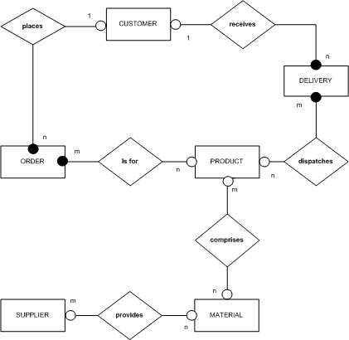
Information Architecture
Information architecture is a static view of information independent of the information systems and IT that use it.
Information systems architecture is a dynamic view of the processes needed to support the information architecture.
Figure 2.12

Slide 21
Information Management
A set of activities to:
Define the information needs of the organization.
Formulate policies for managing information through its life cycle, ensuring that quality information is available to support decision-making.
Develop and implement processes that adhere to the information management policies.

Slide 22
Summary

Slide 23
Topic Learning Outcomes
At the completion of this topic, you will be able to
Explain how the value of information in an organisation can be measured.
Explain a generic information lifecycle in terms of a particular set of information

Slide 24
In the next topic…
The focus shifts to the systems and technologies that are used in organisations to manage the tasks associated with information management
How IT supports information management throughout the information lifecycle
How the value of IT to the organisation can be measured and justified…

